Slide 1
Grad-CAM++
Tianshuang-Wu
Tutor：Shenhuan-Lv
wts001122@qq.com
2024/3/5

Slide 2
Contents
1
Research Background
2
Related Works
3
Grad-CAM++
4
Experiments
5
Conclusion

Slide 3
The lack of understanding of CNN’s internal functioning
Deep learning is a "black box" system.
It works in an "end-to-end" manner, with input data such as RGB images and outputs such as class labels, regression values, etc.
How can we open the "black box" and find out what is going on, so that the "black box" becomes a "gray box" or even a "white box"?
Deep Learning Interpretability
-- Feature Visualization Techniques

Slide 4
Contents
1
Research Background
2
Related Works
3
Grad-CAM++
4
Experiments
5
Conclusion

Slide 5
Related works
Class Activation Mapping
CAM
Grad-CAM
Grad-CAM++

Slide 6
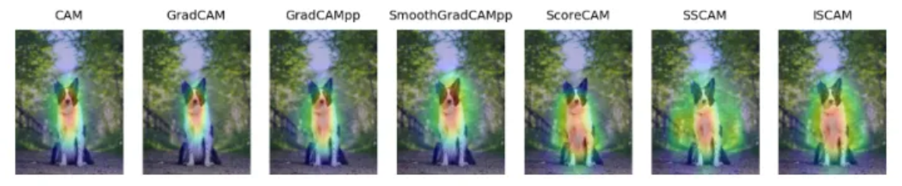
CAM
CAM (Class Activation Mapping), which is also known as class heat map, saliency map, etc.
Is an image of the size of the original image, with pixel values ranging from 0 to 1 at each position, typically represented as a grayscale image from 0 to 255.
It can be understood as the contribution distribution to the prediction output, where a higher score means that the corresponding region of the original picture has a higher response and greater contribution to the network.
Common CAM methods are:

Slide 7
CAM
For a deep convolutional neural network, after multiple convolutions and pooling, its last convolutional layer contains the richest spatial and semantic information, and then it is the fully connected layer and softmax layer, which contains information that is difficult for humans to understand and it is difficult to visualize.
Therefore, in order for convolutional neural networks to give a reasonable explanation for their classification results, we must make full use of the last convolutional layer.

Slide 8
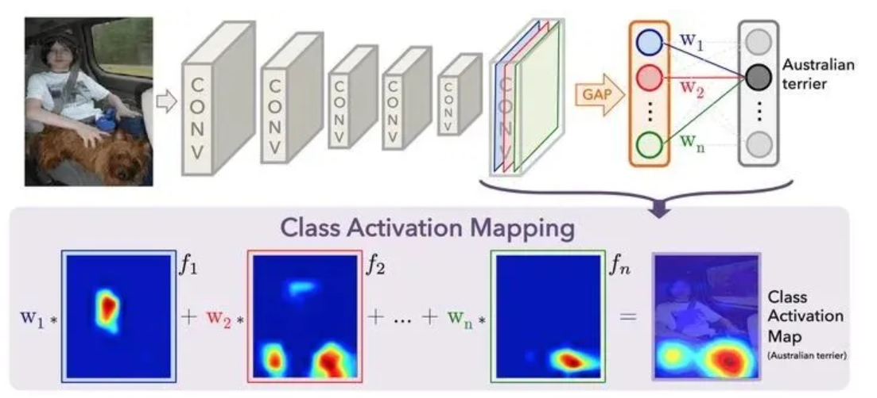
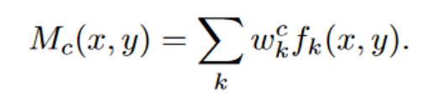
CAM
For a certain class C, we now want to visualize which regions of the original image play a major role in identifying class C, in other words, which information is used by the model to determine that the image is a class C.
We do this by taking the value of the probability of getting class C in the fully connected layer, denoted by W, which is the bottom half of the figure above. Then, the weighted summation is performed on the feature map before the GAP. Since the feature map is not the size of the original image at this time, upsampling is also needed after the weighted summation to obtain the Class Activation Map.

Slide 9
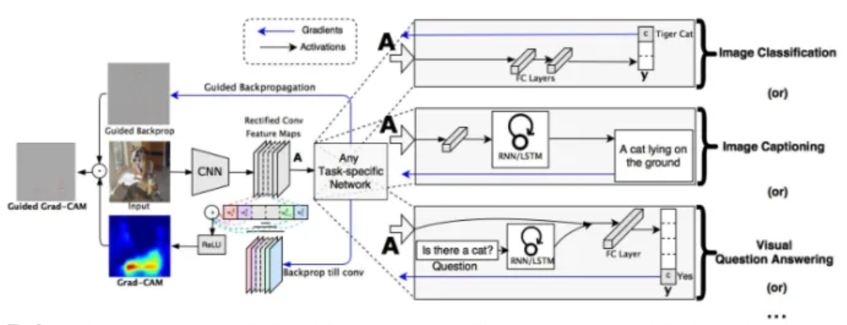
Grad-CAM
The GAP approach to CAM has its limitations:
1) The model must have a GAP layer;
2) Heat maps that can only extract feature maps of the last layer.
Grad-CAM :
It does not need to modify the existing model structure, nor does it need to re-train.
It can be visualized directly on the original model, and the heat map of any layer can be extracted.

Slide 10
Contents
1
Research Background
2
Related Works
3
Grad-CAM++
4
Experiments
5
Conclusion

Slide 11
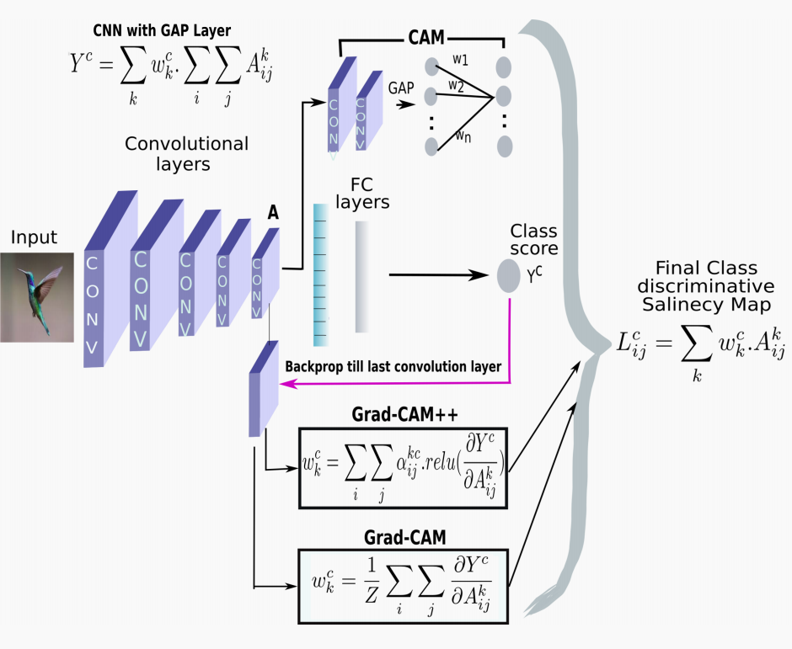
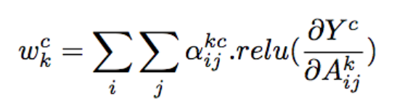
Grad-CAM++
The shortcoming of Grad-CAM:
Multiple occurrences of a class in an image and
poor object localizations.
Each element of the gradient map has a different contribution. The main change is to add ReLU and weight gradient to the weight representation of the feature map corresponding to a certain classification

Slide 12
Contents
1
Research Background
2
Related Works
3
Grad-CAM++
4
Experiment
5
Conclusion

Slide 13
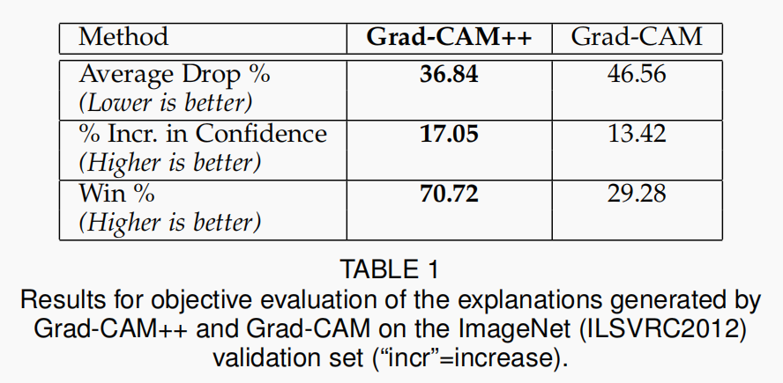
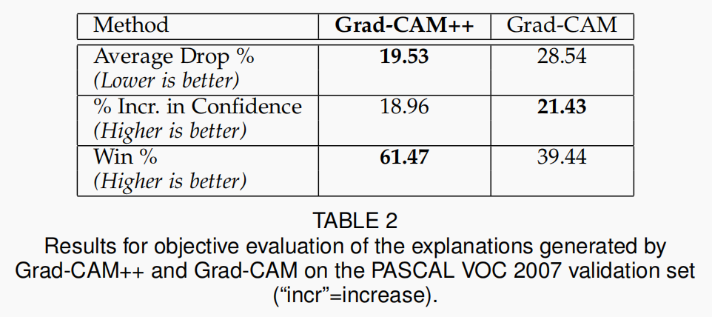
Objective Evaluation for Object Recognition
Average Drop %: A good explanation map for a class should highlight the regions that are most relevant for decision-making.
% Increase in Confidence: Complementary to the
previous metric, it would be expected that there must be scenarios where providing only the explanation map region as input (instead of the full image) rather increases the confidence in the prediction (especially when the context is distracting).

Slide 14
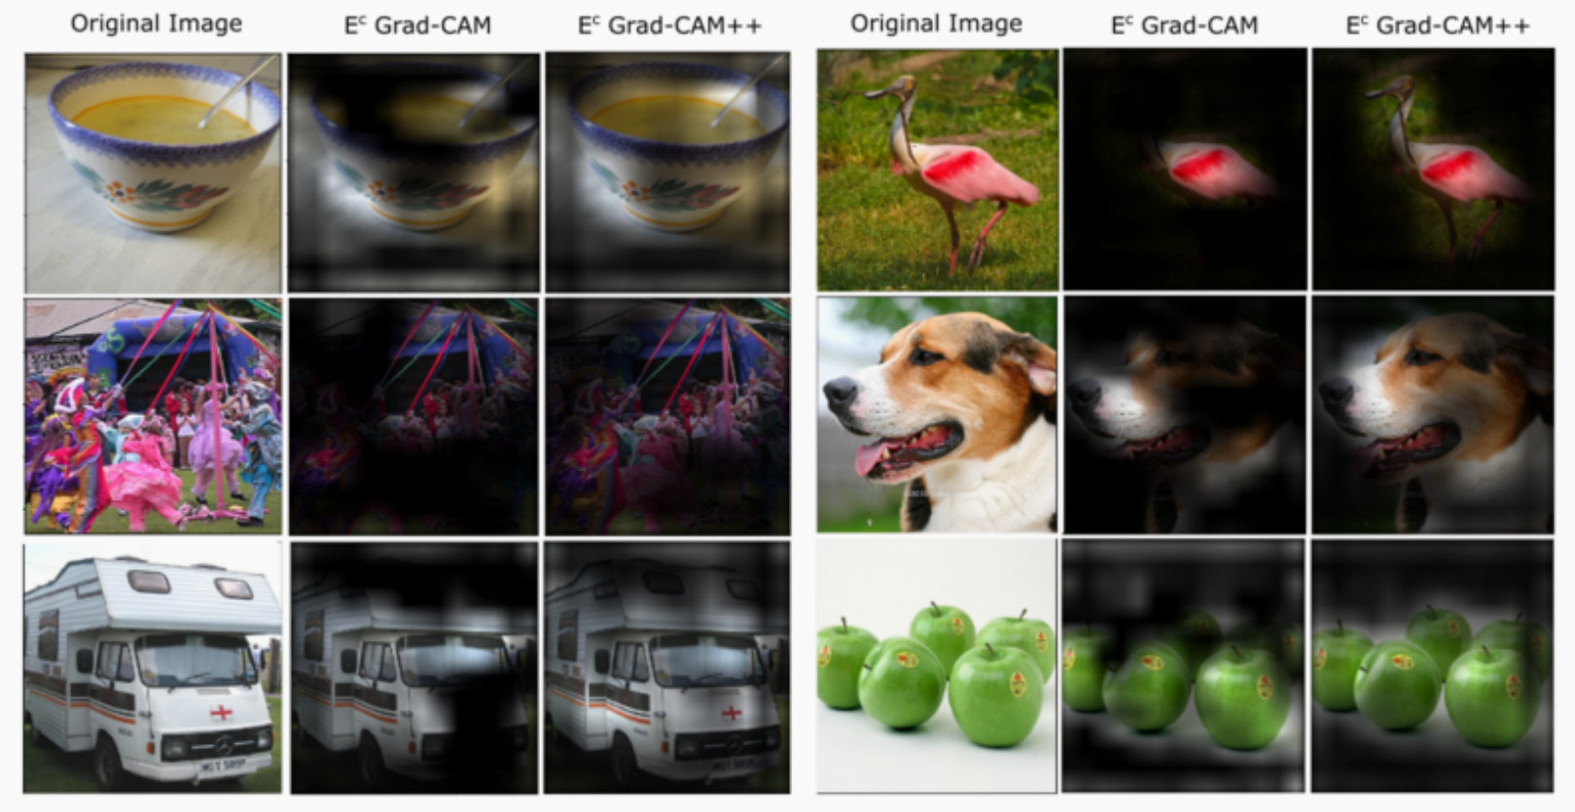
Evaluating Human Trust

Slide 15
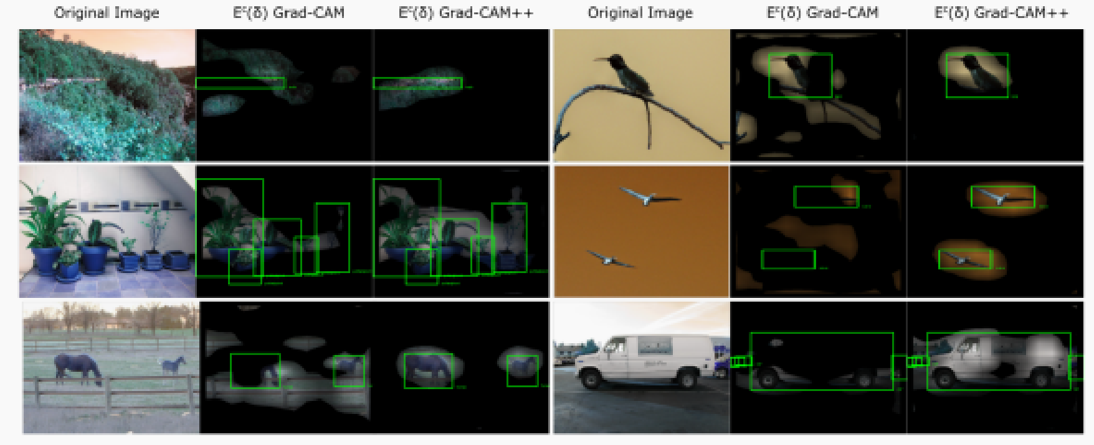
Harnessing Explanations for Object Localization

Slide 16
Contents
1
Research Background
2
Related Works
3
Grad-CAM++
4
Experiments
5
Conclusion

Slide 17
Conclusion and Future Works
Addresses the shortcomings of Grad-CAM especially multiple occurrences of a class in an image and poor object localizations.
Validates the effectiveness of our method both objectively (faithfulness to the model being explained) and subjectively (invoking human trust) using standard well-known CNN models and datasets (ImageNet and Pascal VOC).
Shows that Grad-CAM++ can also prove superior on tasks such as image caption generation and video understanding (action recognition).

Slide 18
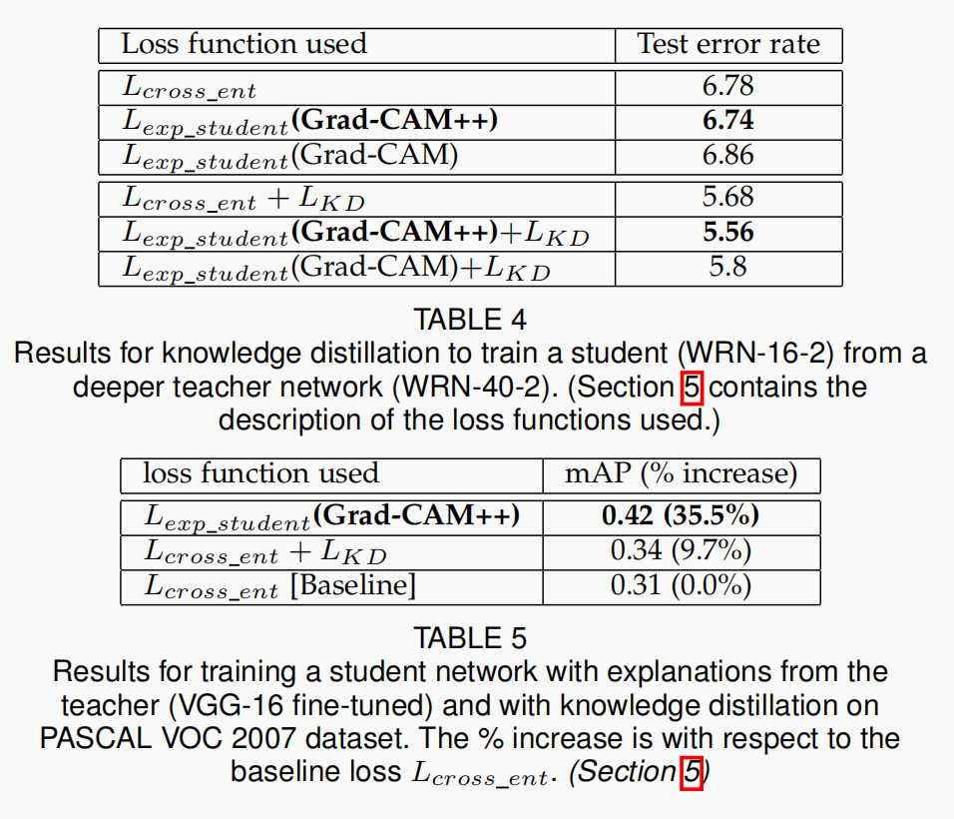
LEARNING FROM EXPLANATIONS: KNOWLEDGE DISTILLATION
In a constrained teacher-student learning setting, knowledge transfer to a shallow student (commonly called knowledge distillation) is possible from the explanation of CNN decisions generated by Grad-CAM++.

Slide 19
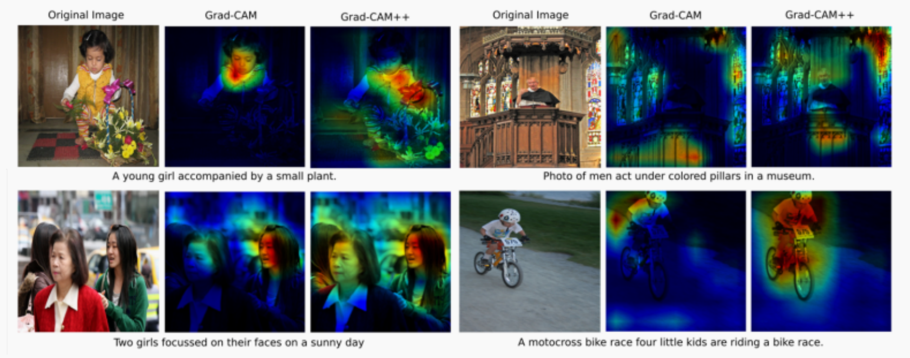
EXPLANATIONS FOR IMAGE CAPTIONING AND 3D ACTION RECOGNITION

Slide 20
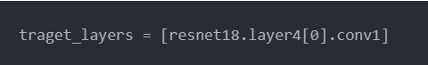
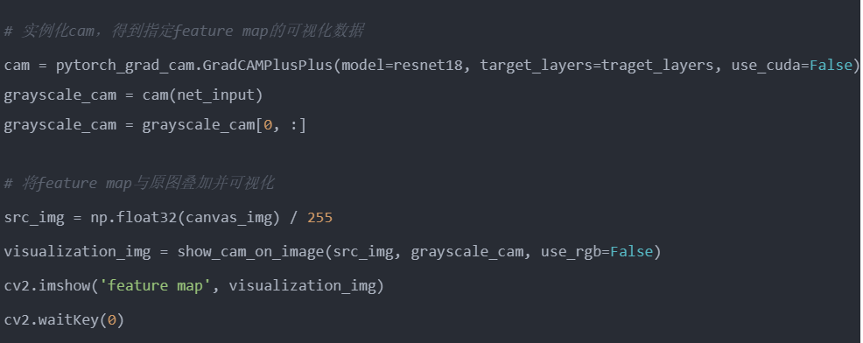
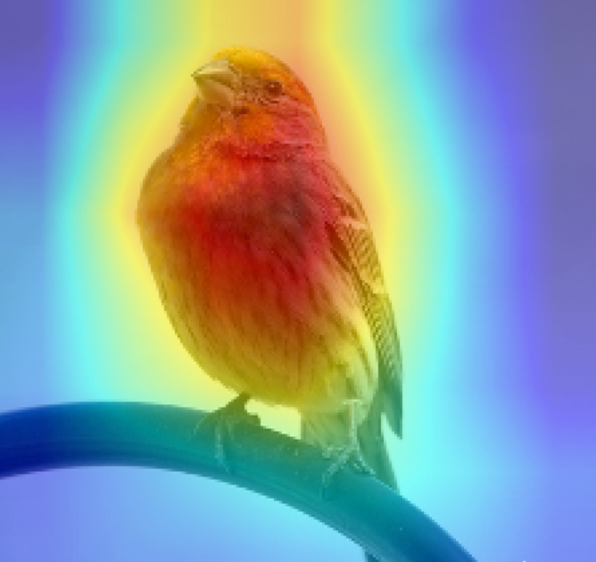
Conclusion and Future Works

Slide 21
Thank you for your
listening and guidance

